Slide 1
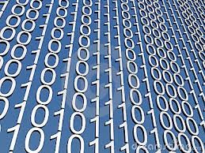
Number Systems and
Number Representation (Rational Numbers)
1

Slide 2
Agenda
Number Systems
Finite representation of unsigned integers Finite representation of signed integers
Finite representation of rational numbers

Slide 3
Number Systems
So far, we have studied the following integer number systems in computer
Unsigned numbers
Sign/magnitude numbers
Two’s complement numbers
What about rational numbers?
A rational number is one that can be expressed as the ratio of two integers
Infinite range and precision
For example, 2.5, -10.04, 0.75 etc

Slide 4
Rational Numbers
Two common notations to represent rational numbers in computer
Fixed-point numbers
Floating-point numbers
Computer science
Finite range and precision
Approximate using floating point number
Binary point “floats” across bits

Slide 5
Fixed-Point Numbers
Fixed point notation has an implied binary point between the integer and fraction bits
The binary point is not a part of the representation but is implied
Example:
Fixed-point representation of 6.75 using 4 integer bits and 4 fraction bits:
The number of integer and fraction bits must be agreed upon by those generating and those reading the number
There is no way of knowing the existence of the binary point except through agreement of those people interpreting the number

Slide 6
Signed Fixed-Point Numbers
As with whole numbers, negative fractional numbers can be represented in two ways
Sign/magnitude notation
Two’s complement notation
Example:
-2.375 using 8 bits (4 bits each to represent integer and fractional parts)
2.375 = 0010 . 0110
Sign/magnitude notation: 1010 0110
Two’s complement notation:
1. flip all the bits: 1101 1001
2. add 1: + 1
1101 1010
Addition and subtraction works easily in computer with 2’s complement notation like integer addition and subtraction

Slide 7
Example
Suppose that we have 8 bits to represent a number
4 bits for integer and 4 bits for fraction
Compute 0.75 + (-0.625)
0.75 = 0000 1100
0.625 = 0000 1010
-0.625 in 2’s complement form: 1111 0110
0.75 0000 1100
+ - 0.625 1111 0110
0000 0010
0.125

Slide 8
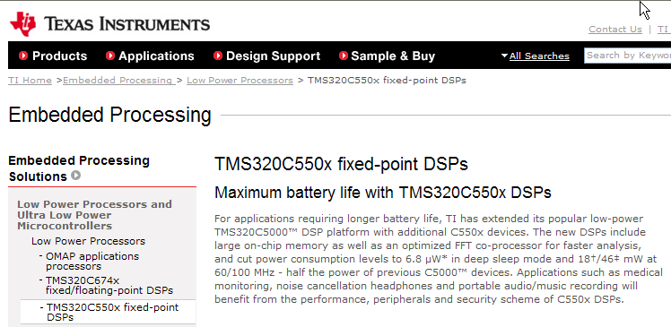
Fixed-Point Number Systems
Fixed-point number systems have a limitation of having a constant number of integer and fractional bits
Some low-end digital signal processors support fixed-point numbers
Example: TMS320C550x TI (Texas Instruments) DSPs: www.ti.com

Slide 9
Floating-Point Numbers
Floating-point number systems circumvent the limitation of having a constant number of integer and fractional bits
They allow the representation of very large and very small numbers
The binary point floats to the right of the most significant 1
Similar to decimal scientific notation
For example, write 273₁₀ in scientific notation:
Move the decimal point to the right of the most significant digit and increase the exponent:
273 = 2.73 × 10²
In general, a number is written in scientific notation as:
± M × B^{E}
Where,
M = mantissa
B = base
E = exponent
In the example, M = 2.73, B = 10, and E = 2 (that is, +2.73 × 10²)

Slide 10
Floating-Point Numbers
Floating-point number representation using 32 bits
1 sign bit
8 exponent bits
23 bits for the mantissa.
The following slides show three versions of floating-point representation with 228₁₀ using a 32-bit
The final version is called the IEEE 754 floating-point standard

Slide 11
Floating-Point Representation #1
First, convert the decimal number to binary
228₁₀ = 11100100₂ = 1.11001 × 2⁷
Next, fill in each field in the 32-bit:
The sign bit (1 bit) is positive, so 0
The exponent (8 bits) is 7 (111)
The mantissa (23 bits) is 1.11001
/ Fraction

Slide 12
Floating-Point Representation #2
You may have noticed that the first bit of the mantissa is always 1, since the binary point floats to the right of the most significant 1
Example: 228₁₀ = 11100100₂ = 1.11001 × 2⁷
Thus, storing the most significant 1 (also called the implicit leading 1) is redundant information
We can store just the fraction parts in the 23-bit field
Now, the leading 1 is implied
0 0 0 0 0 1 1 1
Mantissa /

Slide 13
Floating-Point Representation #3
The exponent needs to represent both positive and negative
The final change is to use a biased exponent
The IEEE 754 standard uses a bias of 127
Biased exponent = bias + exponent
For example, an exponent of 7 is stored as 127 + 7 = 134 = 10000110₂
Thus, 228₁₀ using the IEEE 754 32-bit floating-point standard is
228₁₀ = 11100100₂ = 1.11001 × 2⁷
Mantissa /
Most general purpose processors (including Intel and AMD processors) provide hardware support for double-precision floating-point numbers and operations

Slide 14
IEEE Floating Point Representation
Common finite representation: IEEE floating point
More precisely: ISO/IEEE 754 standard
Using 32 bits (type float in C):
1 bit: sign (0=>positive, 1=>negative)
8 bits: exponent + 127
23 bits: binary fraction of the form 1.ddddddddddddddddddddddd
Using 64 bits (type double in C):
1 bit: sign (0=>positive, 1=>negative)
11 bits: exponent + 1023
52 bits: binary fraction of the form 1.dddddddddddddddddddddddddddddddddddddddddddddddddddd
Mantissa /

Slide 15
Example
Represent -58₁₀ using the IEEE 754 floating-point standard
First, convert the decimal number to binary
58₁₀ = 111010₂ = 1.1101 × 2⁵
Next, fill in each field in the 32-bit number
The sign bit is negative (1)
The 8 exponent bits are (127 + 5) = 132 = 10000100₍₂₎
The remaining 23 bits are the fraction bits: 11010000...000₍₂₎
It is 0xC2680000 in the hexadecimal form
Check this out with the result of the sample program in the slide# 3

Slide 16
Double Precision Example
Represent -58₁₀ using the IEEE 754 double precision
First, convert the decimal number to binary
58₁₀ = 111010₂ = 1.1101 × 2⁵
Next, fill in each field in the 64-bit number
The sign bit is negative (1)
The 11 exponent bits are (1023 + 5) = 1028 = 10000000100₍₂₎
The remaining 52 bits are the fraction bits: 11010000...000₍₂₎
It is 0xC04D000000000000 in the hexadecimal form

Slide 17
Floating-Point Numbers: Special Cases
The IEEE 754 standard includes special cases for numbers that are difficult to represent, such as 0 because it lacks an implicit leading 1
Number | Sign | Exponent | Fraction
0 | X | 00000000 | 00000000000000000000000
∞ | 0 | 11111111 | 00000000000000000000000
- ∞ | 1 | 11111111 | 00000000000000000000000
NaN | X | 11111111 | non-zero
NaN is used for numbers that don’t exist, such as √-1 or log(-5)

Slide 18
Floating Point Example
Sign (1 bit):
1 => negative
Exponent (8 bits):
10000011_{B} = 131
131 – 127 = 4
Fraction (23 bits):
11000001110110110000000000000000
32-bit representation
1.10110110000000000000000_{B}
1 +
(1*2⁻¹)+(0*2⁻²)+(1*2⁻³)+(1*2⁻⁴)+(0*2⁻⁵)+(1*2⁻⁶)+(1*2⁻⁷)
= 1.7109375
Number:
-1.7109375 * 2⁴ = -27.375
Notes:
https://www.youtube.com/watch?v=LXF-wcoeT0o

Slide 19
Floating Point Example
263.3
IEEE754 floating-point standard can’t represent some numbers exactly
2
263
0.3 * 2 | 0.6 | 0
0.6 * 2 | 1.2 | 1
0.2 * 2 | 0.4 | 0
0.4 * 2 | 0.8 | 0
0.8 * 2 | 1.6 | 1
0.6 * 2 | 1.2 | 1
 |  | 0
 |  | 0
 |  | 1
 |  | 1
 |  | 0
2
131
1
2
65
1
2
32
1
2
16
0
2
8
0
2
4
0
2
2
0
2
1
0
Stop when it gets 1.0
0
1
0.3 : 01001100110011….
263: 100000111

Slide 20
Floating Point Example
263.3
100000111.0100110011…
2) Scientific notation:
1.000001110100110011… * 2⁸
Sign (1 bit):
positive => 0
Exponent (8 bits):
127 + 8 = 135
135 = 10000111_{B}
Fraction (23 bits):
00000111010011001100110
Mantissa
0100 0011 1000 0011 1010 0110 0110 0110
32-bit representation
Notes:
https://www.youtube.com/watch?v=8afbTaA-gOQ

Slide 21
Binary Coded Decimal (BCD)
Since floating-point number systems can’t represent some numbers exactly such as 0.3, some application (calculators) use BCD (Binary coded decimal)
BCD numbers encode each decimal digit using 4 bits with a range of 0 to 9
BCD fixed-point notation examples
1.7 = 0001 . 0111
4.9 = 0100 . 1001
BCD is very common in electronic systems where a numeric value is to be displayed, especially, in systems consisting solely of digital logic (not containing a microprocessor) - Wiki
Decimal | BCD Digit
0 | 0000
1 | 0001
2 | 0010
3 | 0011
4 | 0100
5 | 0101
6 | 0110
7 | 0111
8 | 1000
9 | 1001
6.75 = 0110.01110101

Slide 22
Converting Between Decimal and Binary Floating-Point Numbers
https://kyledewey.github.io/comp122-fall17/lecture/week_2/floating_point_interconversions.html

